Slide 1
Trading Team Project Sem-1 2022
March 16th, 2022
16/03/2022

Slide 2
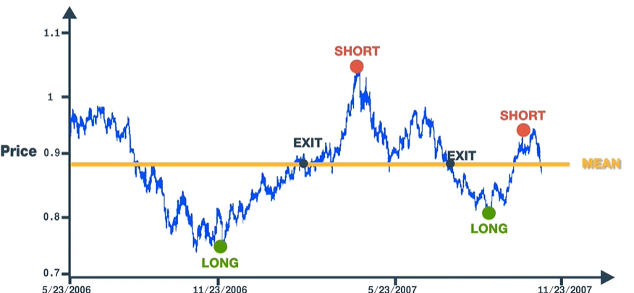
What is Mean Reversion?
‘Mean reversion, or reversion to the mean, is a theory used in finance that suggests that asset price volatility and historical returns eventually will revert to the long-run mean or average level of the entire dataset.’
- Investopedia

Slide 3
Financial Terms used in this presentation
Long: Going long on a stock means purchasing some stock with the hope that it increases in price, to sell at a profit
Short: Going short on a stock means borrowing stock and selling it, with the promise that you will purchase the stock at a later time, the hope is that the stock decreases in value so you can buy it back for less than you sold it, returning a profit.

Slide 4
Mean Reversion – The Basics
Ideally, when a stock is below it’s local mean/average price, you go long on the stock, entering a position in the stock with the hope that it reverts to its mean by increasing in price. Allowing you to sell the stock at a profit.
When a stock is above it’s local mean, you short the stock, selling the stock with the hope that it reverts to its mean by decreasing in price, allowing you to rebuy the stock at a profit.
The trick with mean reversion is identifying when a stock is above or below it’s mean, and what sort of safeguards to have in place if a stock doesn’t revert how you expect it to.

Slide 5
Mean Reversion - Indicators
There are many different indicators that can signal an algorithm to buy or sell a stock. Here are some of the more common ones for Mean Reversion

Slide 6
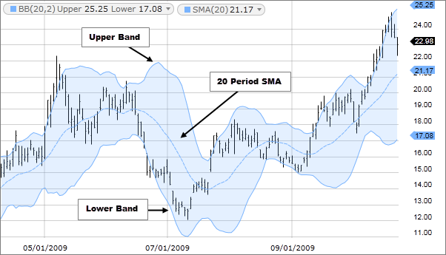
Bollinger Bands
Bollinger Bands are envelopes plotted at a uniform distance above and below the moving average of a price. Usually Bollinger Bands are placed 2 standard deviations from the simple moving average, however this distance can be changed depending on the use-case.
A Close Price above the top band, indicates a deviation from the mean, and could indicate that the price is about to fall to return to its mean. This indication can be interpreted as a good time to short the stock.

Slide 7
Relative Strength Index (RSI)
The Relative Strength Index is a momentum oscillator that measures the speed and change of price movements. It oscillates between 0 and 100. Traditionally the RSI is considered overbought when above 70 and oversold when below 30. You can look at different length periods for RSI, e.g. RSI(2) is when you look at RSI over 2 periods, RSI(3) for 3 periods etc.
If RSI(3) drops to 15, it could be a good time to enter a mean reversion trade, as the stock is oversold and therefore will likely start to increase in price up to its mean, you can then take profit when the RSI reaches back above 50 or 60.

Slide 8
And Many More!
There are a number of other indicators that you can use to identify when to buy an sell for a mean reversion strategy. For example:
Stochastics Indicator
Internal Bar Range
Volatility Index (VIX)
Etc
You will also likely want to incorporate Stop Losses and Take Profits into your strategy, as with all quantitative strategies, there is significant risk involved, especially when dealing with shorts.

Slide 9
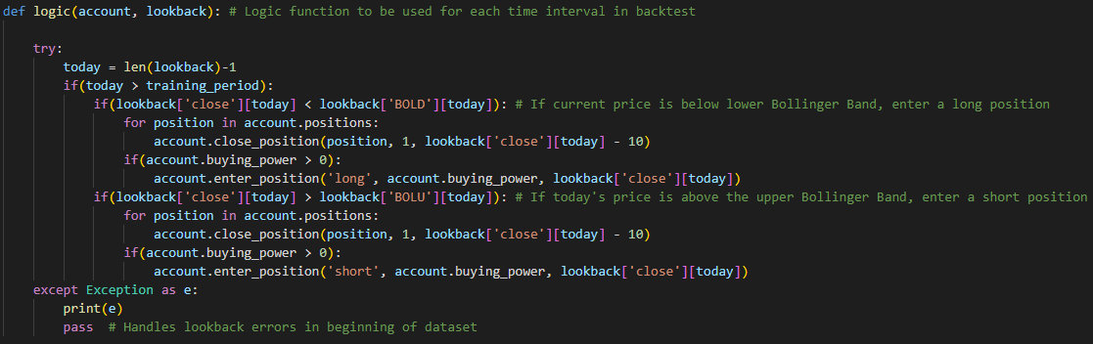
How do we create a strategy?
Developing a strategy using the back-testing framework provided involves creating a logic function, which is run on each row of the input data to decide whether or not to buy, sell or hold the stock in that time period.

Slide 10
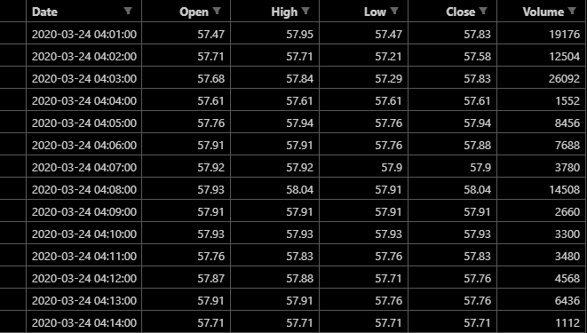
The Data
Data can be pulled from our data API, in many different forms. We will be testing the algorithms on data consisting of 1 minute time intervals.
The Data has the date, open price, high price, low price, close price and volume traded as it’s columns. Other columns can be calculated and appended at your discretion (Example later).

Slide 11
Code Walkthrough
Here I’ll give a walkthrough of the skeleton code that I’ve given you. I would recommend reading through it at the same time on your computers. Most of it is fairly well documented, but if you need any help understanding anything please reach out to me.

Slide 12
Project Details
Project Details:
Within your team, your goal is to build a trading strategy based on Mean Reversion
Fees: 0.1% per trade or $10 per trade flat rate (whichever is less), buy and sell.
Starting Balance: $5,000
Data Resolution: 1 minute data will be tested
Data Source: Will be tested on random stocks in Top 500 American Companies.

Slide 13
Timeline of the Project
Start of the Project
Today!
Due Date
End of Study Week (Week 8). Roughly 24th April
Midway Meeting
Sometime in Week 5 (According to availability)

Slide 14
Team Structure
3-4 members per group
Groups have been allocated according to perceived skill level so that all teams should be relatively equally skilled
Team Leaders are responsible for setting up meetings and submitting the final report at the end.

Slide 15
Split off into your teams and introduce yourselves
Team 1
TL: Talin
Nenmar
Jackson B
Team 2
TL: Harrison
Henry
Kane
Team 3
TL: Jake
Jack
Zachary
Nicholas
Team 4
TL: Zach M
Kai
Isaac

Slide 16
Cloning the repository
Clone the git repo on the QFin UWA GitHub page:
- According to your Team Number

